Slide 1

Website Development: Lesson 10
Facilitated by: Salma & Vicente
Notes:
Web development kahoot

Slide 2
Agenda
1. Ice breaker
2. Recap
3. Navigation Bar
4. Coding the HTML of a NavBar
5. Coding CSS of NavBar
6. Q&A
7. Lesson 5: Navbar html

Slide 3

Ice Breaker
Language (or computer language) you want to learn and why?

Slide 4
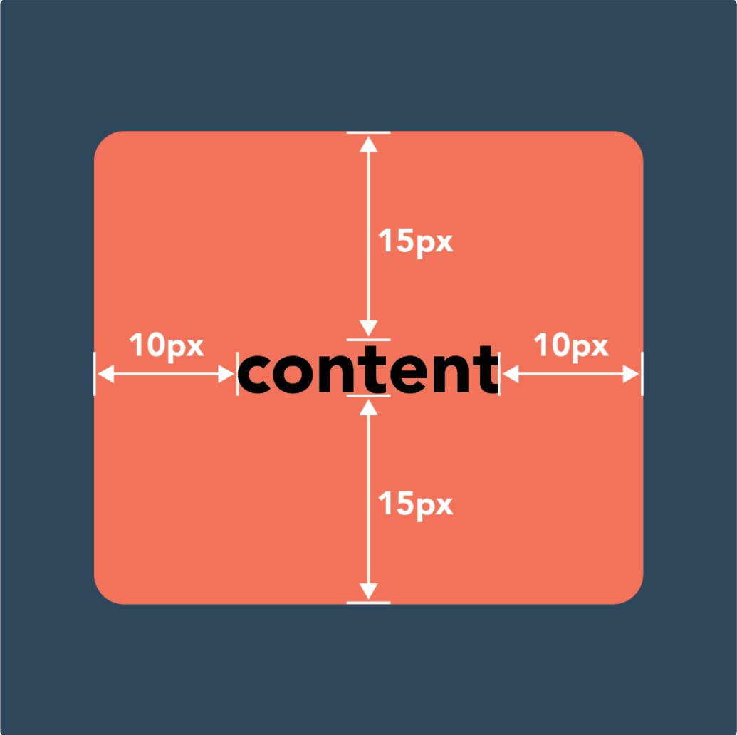
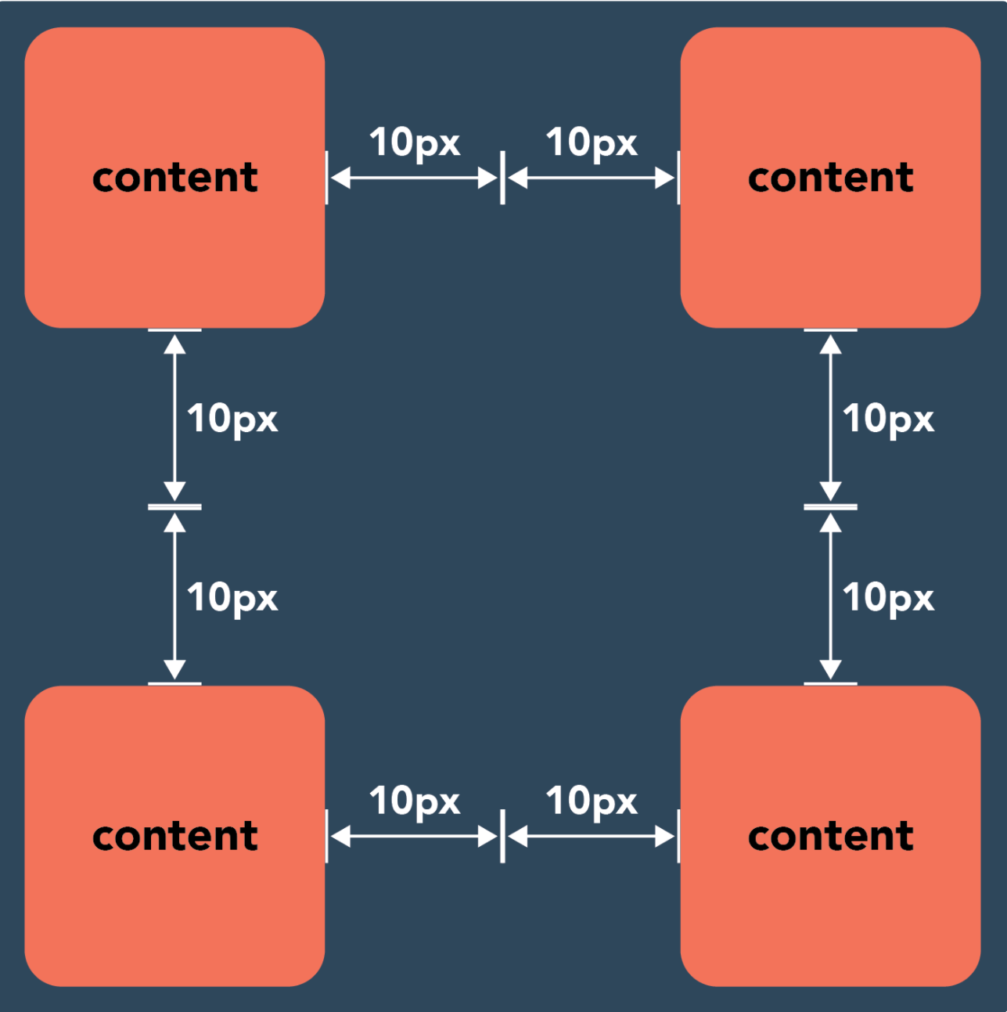
Recap
Padding vs. Margins
Padding:
The space inside an element
Can add space between the edge of an element and the core content
Ex: when creating a button with words
Margins:
The space around each element
Helps to redefine the look of your webpage
*both are coded in CSS and have short and longhand ways to write them out

Slide 5
Navigation Bar (NavBar)
What is the NavBar?
List of links that help you navigate the website.
Similar to jumping

Slide 6
NavBar
Example: A NavBar on Apple.com

Slide 7
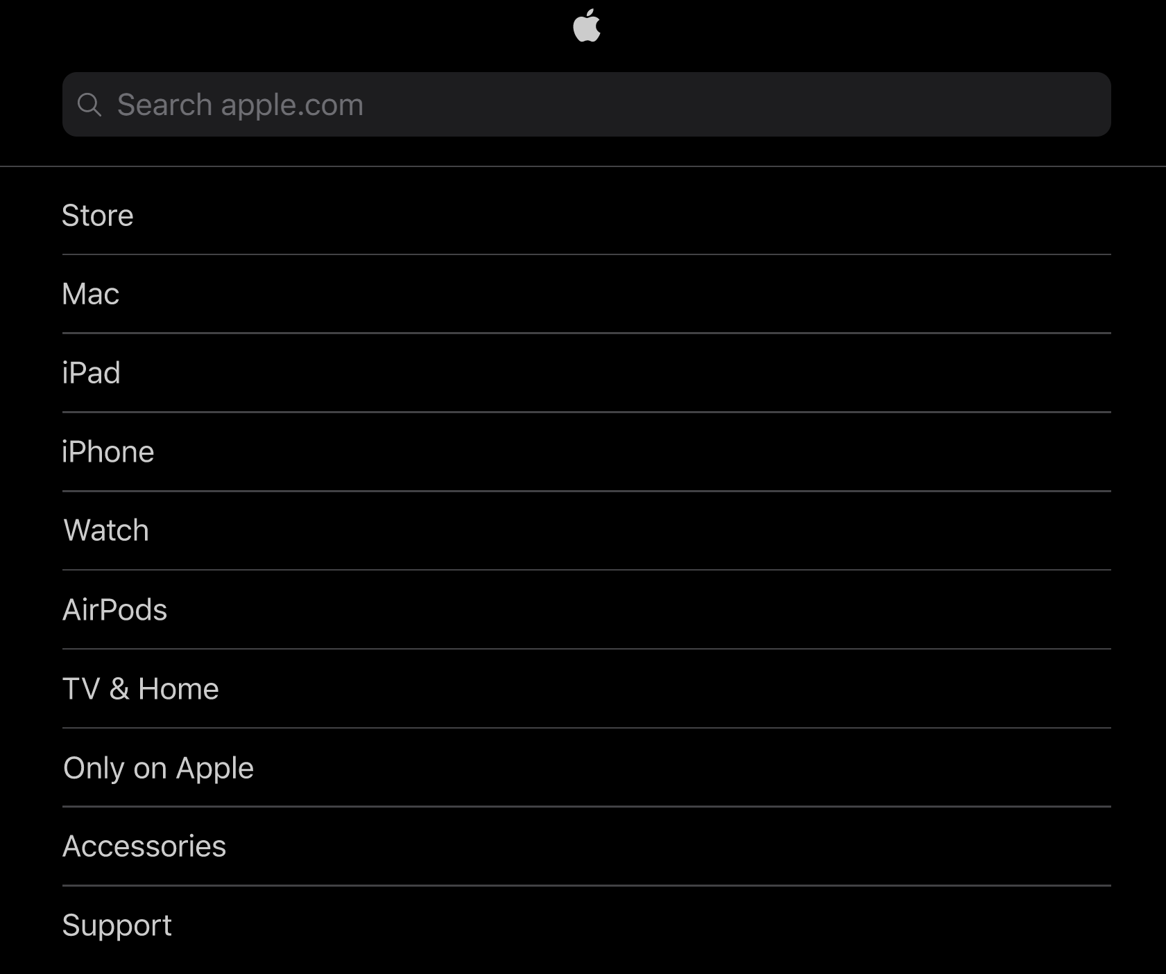
NavBar
Another NavBar on Apple.com

Slide 8
NavBar
Both Apple NavBars (next slide)

Slide 9
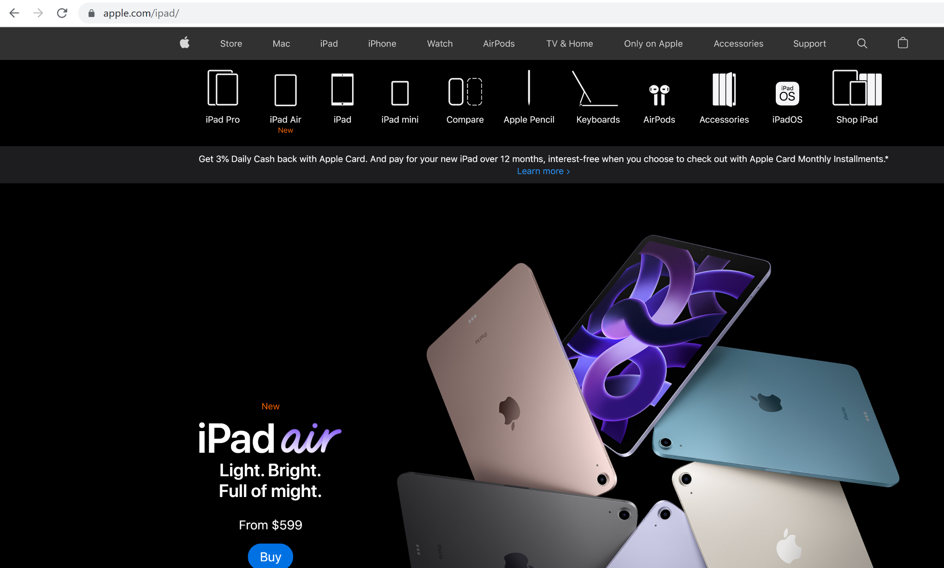
NavBar

Slide 10
NavBar
Why is the NavBar Useful?
The NavBar allows the user to jump from one part of the website to another (like jumping)
It should appear on all web pages within a site
It also highlights the most important content

Slide 11

NavBar
Why is the NavBar Useful?
This is the UW College of Engineering NavBar.
It shows the important stuff people need to see when visiting that website.
OPTIONAL: Visit the UW website to see the navbars.

Slide 12
HTML of NavBar
Navbar code HTML
<div class="topnav">
<a class="active"href=”#home”>Home</a>
<a href="#news">News</a>
<a href="#contact">Contact</a>
<a href="#about">About</a>
</div>

Slide 13
HTML of NavBar
Navbar code CSS
.topnav {
background-color: #333;
overflow: hidden;
}
.topnav a {
float: left;
color: #f2f2f2;
text-align: center;
padding: 14px 16px;
text-decoration: none;
font-size: 17px;
}
.topnav a:hover {
background-color: #ddd;
color: black;
}
.topnav a.active {
background-color: #04AA6D;
color: white;
}
A black background to the top navigation
Styling the links on the navbar.
Changing the color of links when hovering.
Add a color to the link you’re on right now.

Slide 14
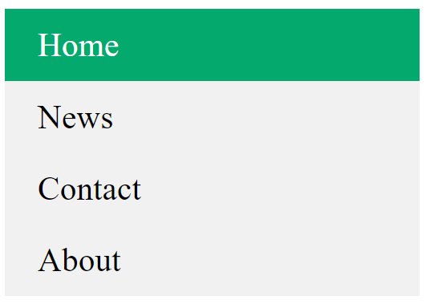
CSS of NavBar
Your Navbar would look something like this.

Slide 15
CSS of NavBar
More things you can do with NavBar using CSS
Dropdown menu
Hide the elements of NavBar until you click on dropdown icon
Adding borders
Changing background and text colors
Creating extra width/height so the rer
Resource: https://www.w3schools.com/css/css_navbar.asp

Slide 16

Questions?

Slide 17
Lesson 4: NavBar
Let’s create a Navigation Bar
Refer to slides #12 & #13 for the HTML & CSS codes

Slide 18

Lesson 4: NavBar
You’d have something that looks like this:

Slide 19
Questions?

